Slide 1
Building an API
The basics of building modern Application Programmer Interfaces with a focus on REST and ASP.NET Web API
With Jay VanOrd, MCP

Slide 2
What is an API and Why do I want one?
Application Programmer Interfaces provide an entry point for other programmers into your code.
Third-Party Access to Functionality or Data
Support Multiple User Interfaces on Different Platforms
Clean, Logical, and Secure Separation of Components or Layers

Slide 3
A brief history of APIs In the Microsoft Developer EcosysTem
Object Linking and Embedding (OLE) and ActiveX (COM)
Windows RPC
Simple Object Access Protocol (SOAP)
Windows Communication Framework (WCF)
Web API
ASP.NET Core

Slide 4
What is REST?
Representational State Transfer
“Architectural Styles and the Design of Network-based Software Architectures” – Roy T. Fielding, 2000
REST is a Design Pattern for APIs, not an API
REST is not dependent on HTTP
REST is not JSON
Resources vs. Representations

Slide 5

What is RESTful?
Client-Server
Stateless
Cacheable
Uniform Interface
Layered System
Code on Demand*
HATEOAS and Self-Discovery

Slide 6
Rest over HTTp
Representation + Metadata ⬄ Body + Headers
Media Types
Status Codes
Location Headers
HTTP Verbs ⬄ Uniform Interface
POST ⬄ Create
GET ⬄ Read (Safe; Cacheable; Idempotent)
PUT ⬄ Update (Idempotent)
PATCH ⬄ Update Partial (Idempotent)
DELETE ⬄ Delete (Idempotent)

Slide 7
Practical REST Restful vs Rest-ish
Useful vs. RESTful
Know Your Audience
Web API is a Specific Implementation

Slide 8
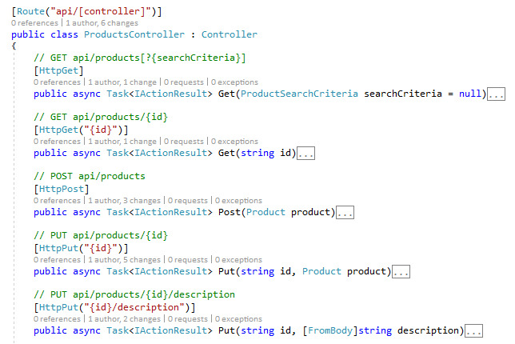
Practical REST Web API REqUests
URIs and Verbs
Controllers, Actions, Routes
Naming Conventions
HTTP Attributes
Parameter Binding

Slide 9
Practical REST Web API REsponses
POCO Results
IActionResult
Ok(), NotFound(), BadRequest(), NoContent(), etc.
Error Handling
try { } catch { }
Exception Filter Attributes
Secure Your Error Messages
Content Types
Content Negotiation
Media Type Formatters

Slide 10
Practical REST Patching in Web API
Nullable Fields
Custom Parameter Binding
Single-Property Representation
JSON Patch

Slide 11
Practical REST Security and Authentication
ASP.NET Authentication
Bearer Tokens
OAuth2
OpenID Connect
CORS
JSONP

Slide 12
Practical REST changes and versioning
URI Permanence
Backward Compatibility
Versioned URI Paths
Vendor Media Types with Version

Slide 13
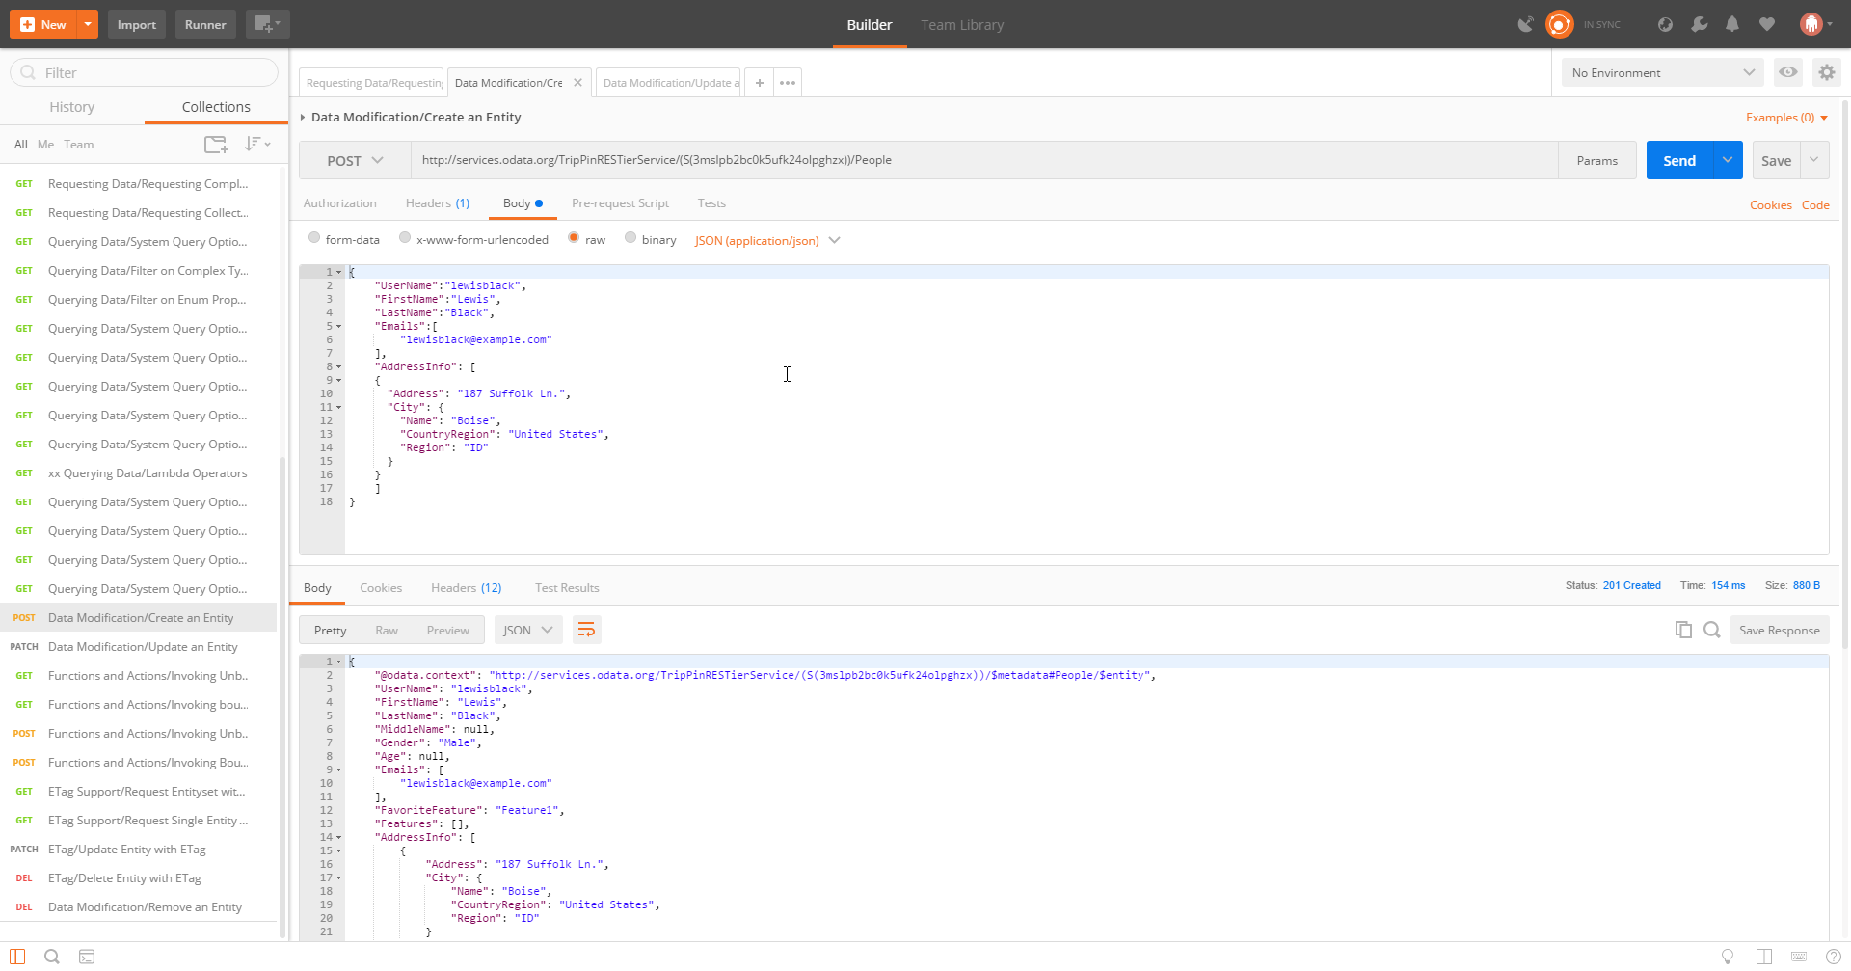
Practical Rest Open Data Protocol (ODATA)
ISO Standard
RESTful
Libraries for .NET, Java, Node.js, etc.
VS Code Extension

Slide 14
Supporting Your API
Traditional Documentation
Examples and How-Tos
Abstract and Encapsulate Complication
In-App Documentation

Slide 15
SHOW ME THE MONEY CODE!

Slide 16
Limitations of REST and Web API
Synchronous Request-Response
No Callbacks or Server-Initiated Communication
Representations over Actions
Unstructured Data Representations
Complex Security Implementations
Error Responses

Slide 17
Alternatives to REST
SOAP
WCF
GraphQL (Facebook)
FALCOR (Netflix)
WebSockets
MQTT
Rabbit MQ

Slide 18
Real-World Rest(ish) ApIs
GitHub https://developer.github.com/v3/
Google Maps https://developers.google.com/maps/
PayPal https://developer.paypal.com/docs/api/
Twilio http://www.twilio.com/docs/api/rest

Slide 19
References and Resources
Roy T. Fielding’s Dissertation: http://www.ics.uci.edu/~fielding/pubs/dissertation/top.htm
JSON Patch: http://jsonpatch.com/
ODATA: http://www.odata.org/

Slide 20
Summary
Fork Me: https://github.com/jvanord/stpete-dotnet-building-apis
Remember:
Useful > RESTful
Know Your Audience
TBYC (Think Before You Code)
Q & A

